Slide 2

YPP 4th
bbv Software Services AG | Date

Slide 3




Presentation on Trello Functionalities
bbv Software Services AG | Date: 08/05/2025

Slide 4
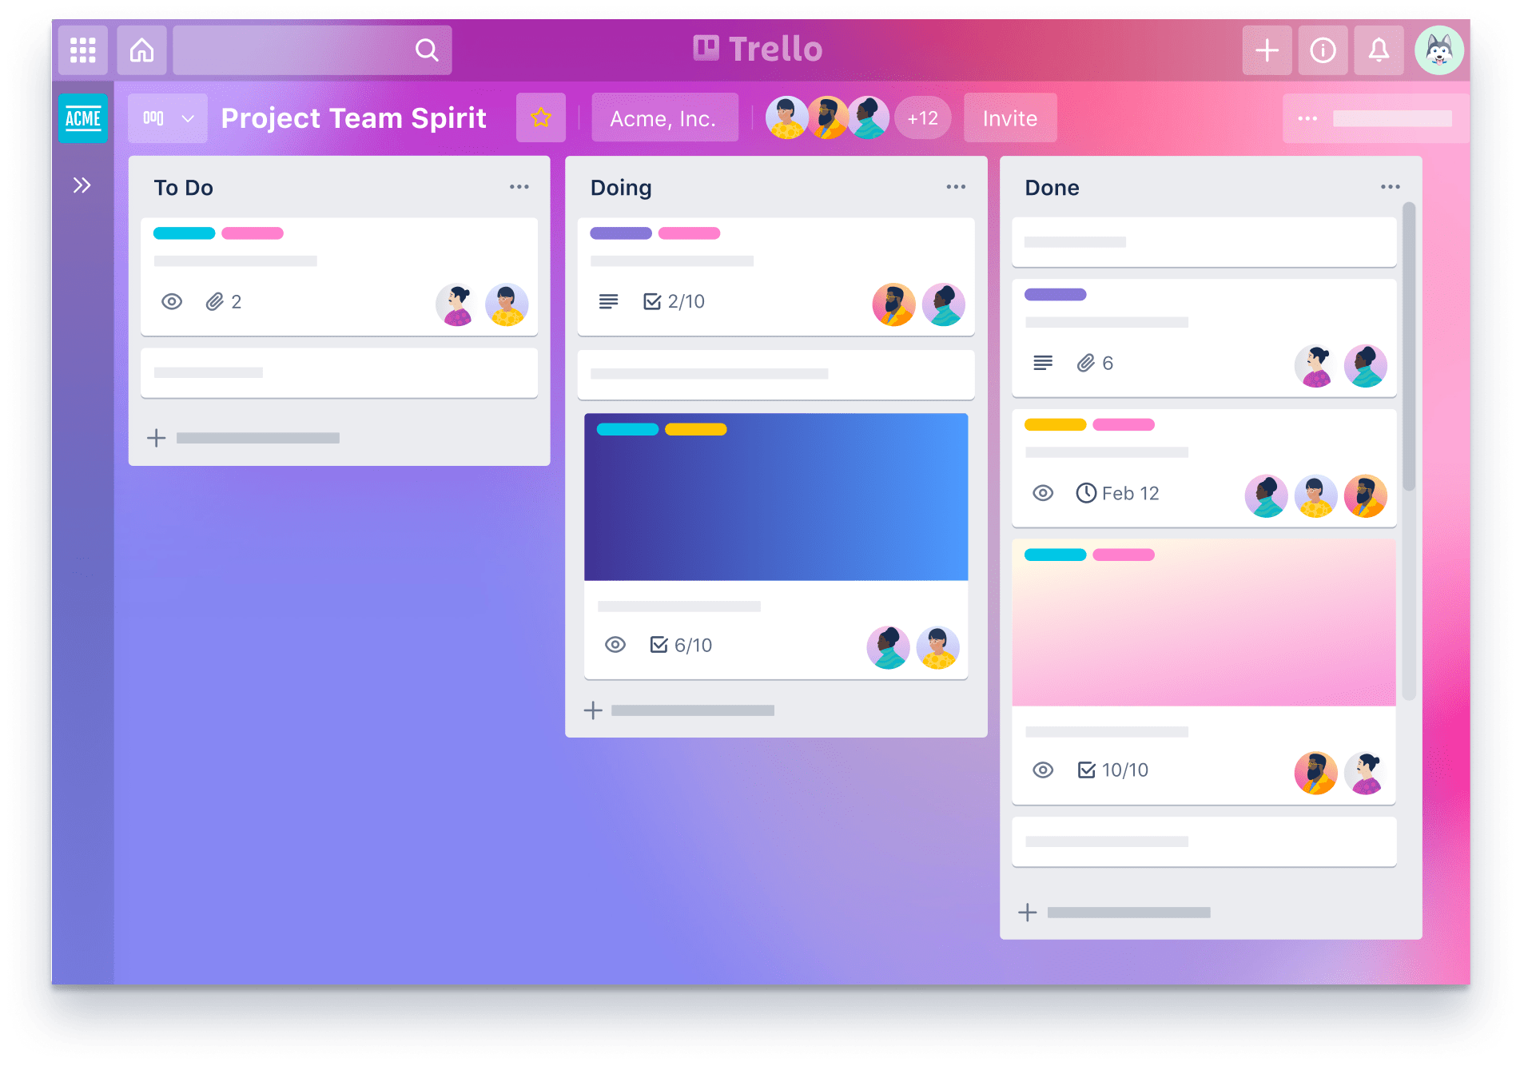
Agenda
Introduction
Functionality
UI Screens in the Trello
Entities and Relationship in Trello
Q&A

Slide 5

INTRODUCTION
What is Trello?

Slide 6
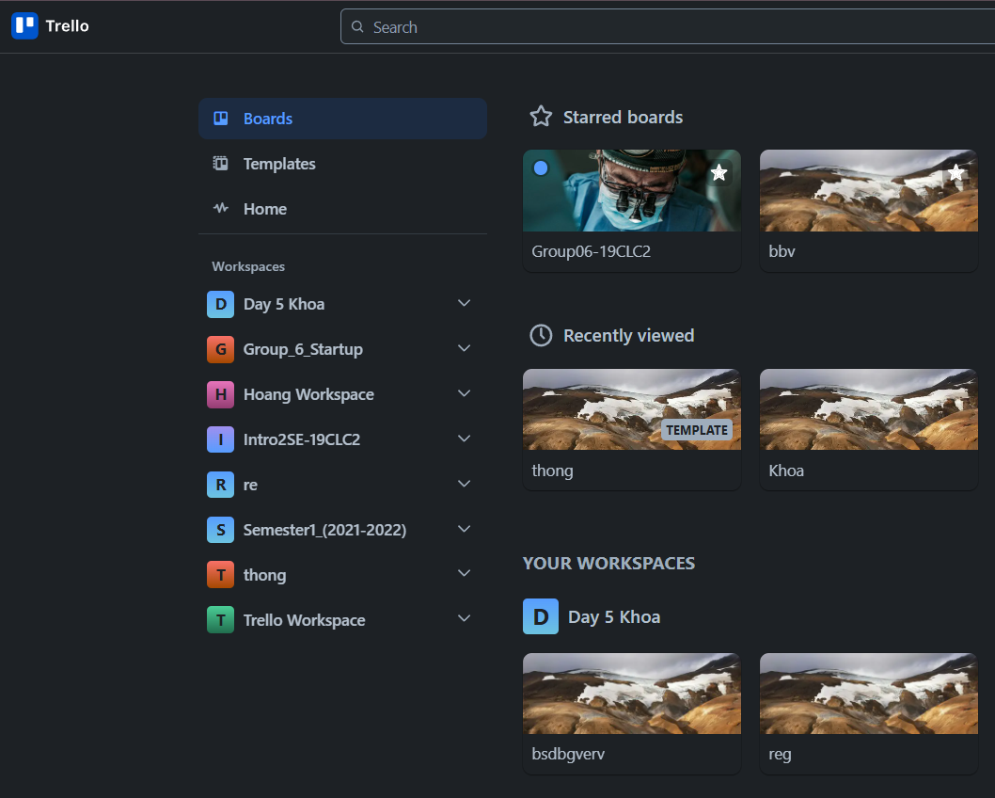
Introduction
What is Trello
Trello is a tool, organize for managing projects, tasks and track progress.
Let’s users:
Create workspace boards
Add cards to represent tasks
Add checklists to break tasks into subtasks
Set due dates to track deadlines

Slide 7

Key Functionalities

Slide 8
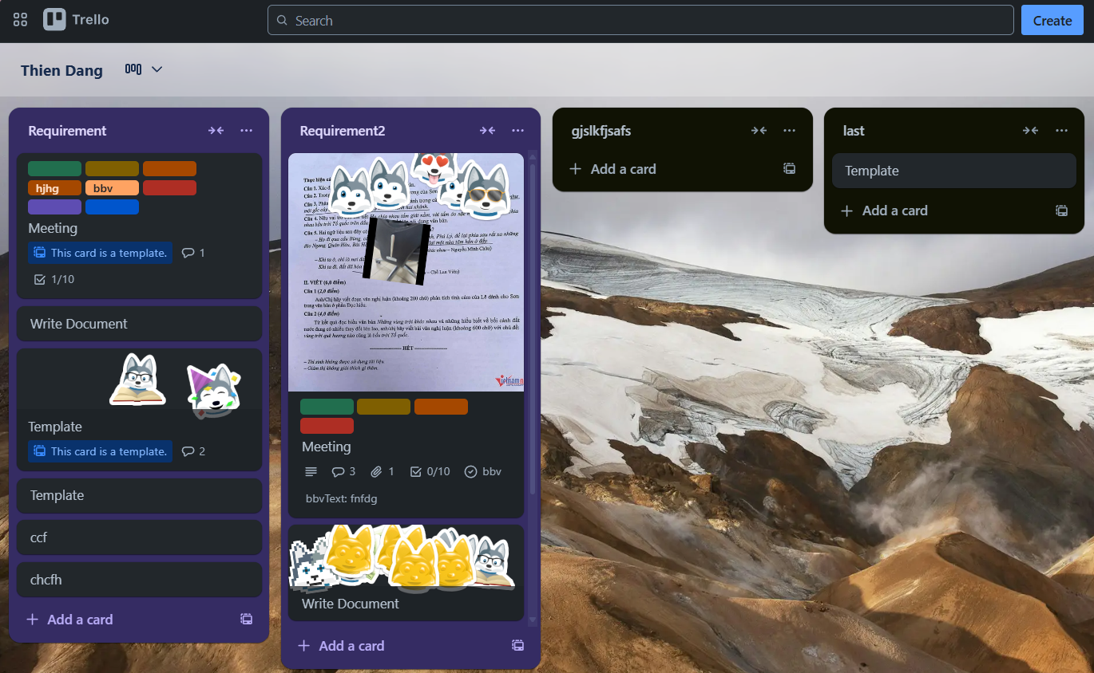
Key Functionalities
Create and manage Workspaces for different projects
Create Boards to organize tasks
Create Cards with due dates, custom field, label, checklists, and attachments.
Assign Member to Workspace, Board, Card
Comment and Activity on Cards
Use Teamplates for setup project
Collaborate and manage Members & Permissions

Slide 9
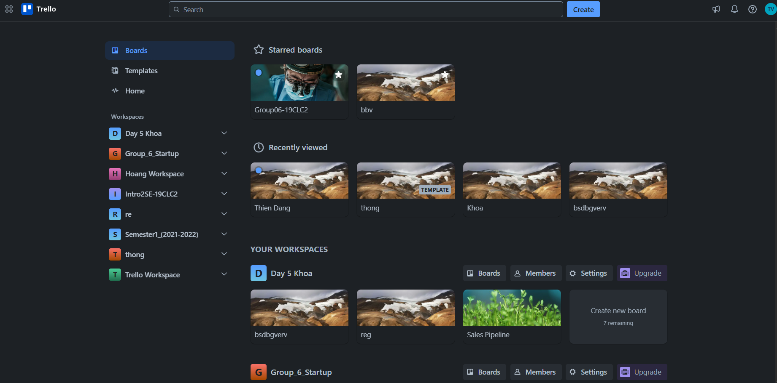
BOARDS TAB SCREEN
UserStarredBoard
User
StarredBoardStatus
Board
UserViewHistory
BackgroundUrl
Worksapce
BoardName
IsTemplate
Member
LogoUrl
WorkspaceName
Notes:
-- BOARDS TAB SCREEN
-- Get Avatar User
SELECT Id, PictureUrl
FROM Users usr
WHERE usr.Id = 1
-- Get the all starred boards by the specific user(id=8).
SELECT usb.UserId, brd.Id BoardId, brd.BackgroundUrl, brd.BoardName, brd.BoardStatus
FROM UserStarredBoard usb
JOIN Board brd ON brd.Id = usb.BoardId
WHERE UserId = 1 AND brd.BoardStatus = 'active' AND usb.StarredBoardsStatus = 1
ORDER BY usb.CreatedAt DESC;
-- recently viewed boards
-- Get 4 recently viewed boards by specific user(id=1)
SELECT TOP 4 brd.Id, brd.BoardName, brd.BackgroundUrl, uvh.AccessedAt, brd.BoardStatus
FROM Board brd
JOIN UserViewHistory uvh ON uvh.OwnerId = brd.Id
JOIN OwnerType owt ON owt.Id = uvh.OwnerTypeId
WHERE uvh.UserId = 5 AND owt.OwnerTypeValue = 'BOARD' AND brd.BoardStatus = 'active'
ORDER BY uvh.AccessedAt DESC;
-- Get all workspace that specific User(id=1) is member
SELECT wsp.Id WorkspaceId, wsp.WorkspaceName, wsp.LogoUrl
FROM Workspace wsp
JOIN Members meb ON meb.OwnerId = wsp.Id
JOIN OwnerType owt ON owt.Id = meb.OwnerTypeId
JOIN Users usr ON usr.Id = meb.UserId
WHERE owt.OwnerTypeValue = 'WORKSPACE' AND meb.UserId = 1
ORDER BY wsp.CreatedAt;
-- Get list all board that specific User(i=1) is member for specific Workspace(id=1)
SELECT brd.Id AS BoardId, brd.BoardName AS BoardName, wsp.WorkspaceName AS WorkspaceName, brd.BackgroundUrl
FROM Board brd
JOIN Members mbr ON mbr.OwnerId = brd.Id
JOIN OwnerType owt ON owt.Id = mbr.OwnerTypeId
JOIN Workspace wsp ON brd.WorkspaceId = wsp.Id
JOIN Users usr ON mbr.UserId = usr.Id
WHERE usr.Id = 1 AND owt.OwnerTypeValue = 'BOARD' AND wsp.Id = 1
ORDER BY brd.CreatedAt;

Slide 10
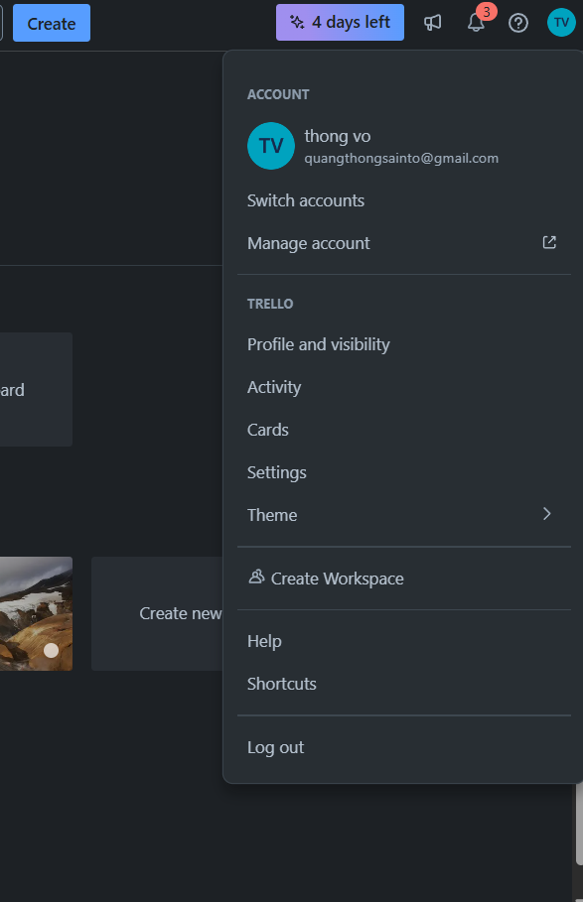
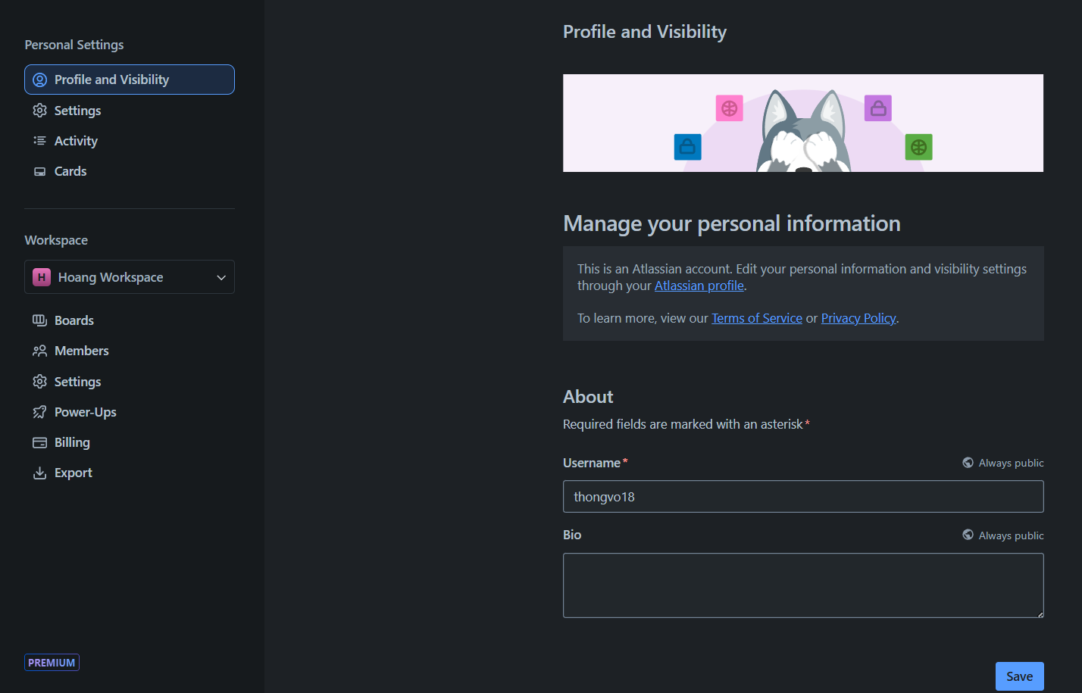
USER SCREEN
User
PictureUrl
Email
User
Click here
Username
Bio
Notes:
-- USER TAB SCREEN
-- Get information of a specific user
SELECT Id, PictureUrl, Email, Username
FROM Users
WHERE Email = 'mkelly@gmail.com'

Slide 11
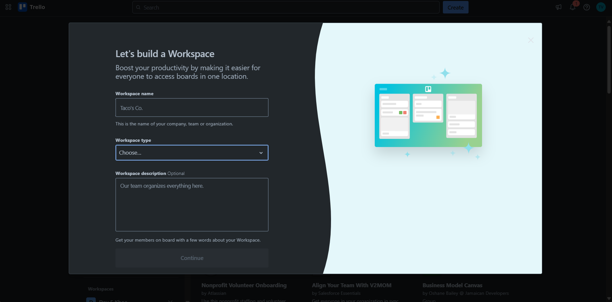
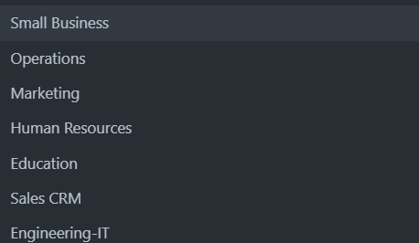
WORKSPACE CREATE SCREEN
WorkspaceType
WorkspaceName
WorkspaceType
WorkspaceTypeName
Workspace
Click here
WorkspaceDescription
Notes:
--WORKSPACE CREATE SCREEN
--Get all workspace types
SELECT Id, TypeValue, DisplayValue
FROM WorkspaceType;

Slide 12
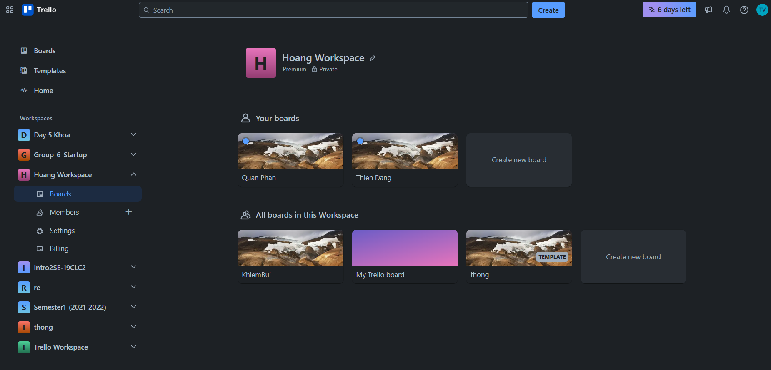

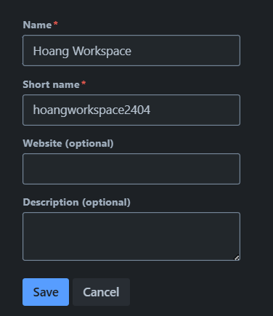
WORKSPACE SCREEN
WorkspaceName
Click here
Workspace
LogoUrl
Worksapce
SettingValue
WorkspaceName
BillingPlan
User
ShortName
Website
Board
WorkspaceDescription
Member
IsTemplate
BackgroundUrl
Board
BoardName
Notes:
-- WORKSPACE SCREEN
-- Get all workspace that specific User(id=1) is member (R)
SELECT wsp.Id WorkspaceId, wsp.WorkspaceName, wsp.LogoUrl
FROM Workspace wsp
JOIN Members meb ON meb.OwnerId = wsp.Id
JOIN OwnerType owt ON owt.Id = meb.OwnerTypeId
JOIN Users usr ON usr.Id = meb.UserId
WHERE owt.OwnerTypeValue = 'WORKSPACE' AND meb.UserId = 1
ORDER BY wsp.CreatedAt;
-- Get all boards in specific Workspace(id=1) that specific user(id=1) is owner.
SELECT brd.Id BoardId, brd.BoardName, brd.BackgroundUrl, wsp.Id WorkspaceId, wsp.WorkspaceName, brd.CreatedBy, brd.CreatedAt
FROM Board brd
JOIN Members meb ON meb.OwnerId = brd.Id
JOIN Workspace wsp ON wsp.Id = brd.WorkspaceId
JOIN OwnerType owt ON owt.Id = meb.OwnerTypeId
WHERE owt.OwnerTypeValue = 'BOARD' AND brd.CreatedBy = meb.UserId AND meb.UserId = 1 AND wsp.Id = 2
ORDER BY brd.CreatedAt;
-- Get all boards in specific Workspace(id=1) that specific user(id=1) is member.(R)
SELECT brd.Id BoardId, brd.BoardName, brd.BackgroundUrl, wsp.Id WorkspaceId, wsp.WorkspaceName, brd.CreatedBy, brd.CreatedAt
FROM Board brd
JOIN Members meb ON meb.OwnerId = brd.Id
JOIN Workspace wsp ON wsp.Id = brd.WorkspaceId
JOIN OwnerType owt ON owt.Id = meb.OwnerTypeId
WHERE owt.OwnerTypeValue = 'BOARD' AND wsp.Id = 2 AND meb.UserId = 1
ORDER BY brd.CreatedAt;
-- Get specific Workspace that specific user is a member. (R)
SELECT wsp.Id WorkspaceId,wsp.WorkspaceName, wsp.LogoUrl
FROM Workspace wsp
JOIN Members meb ON meb.OwnerId = wsp.Id
JOIN OwnerType owt ON owt.Id = meb.OwnerTypeId
WHERE owt.OwnerTypeValue = 'WORKSPACE' AND meb.UserId = 1 AND wsp.Id = 3
ORDER BY wsp.CreatedAt;

Slide 13
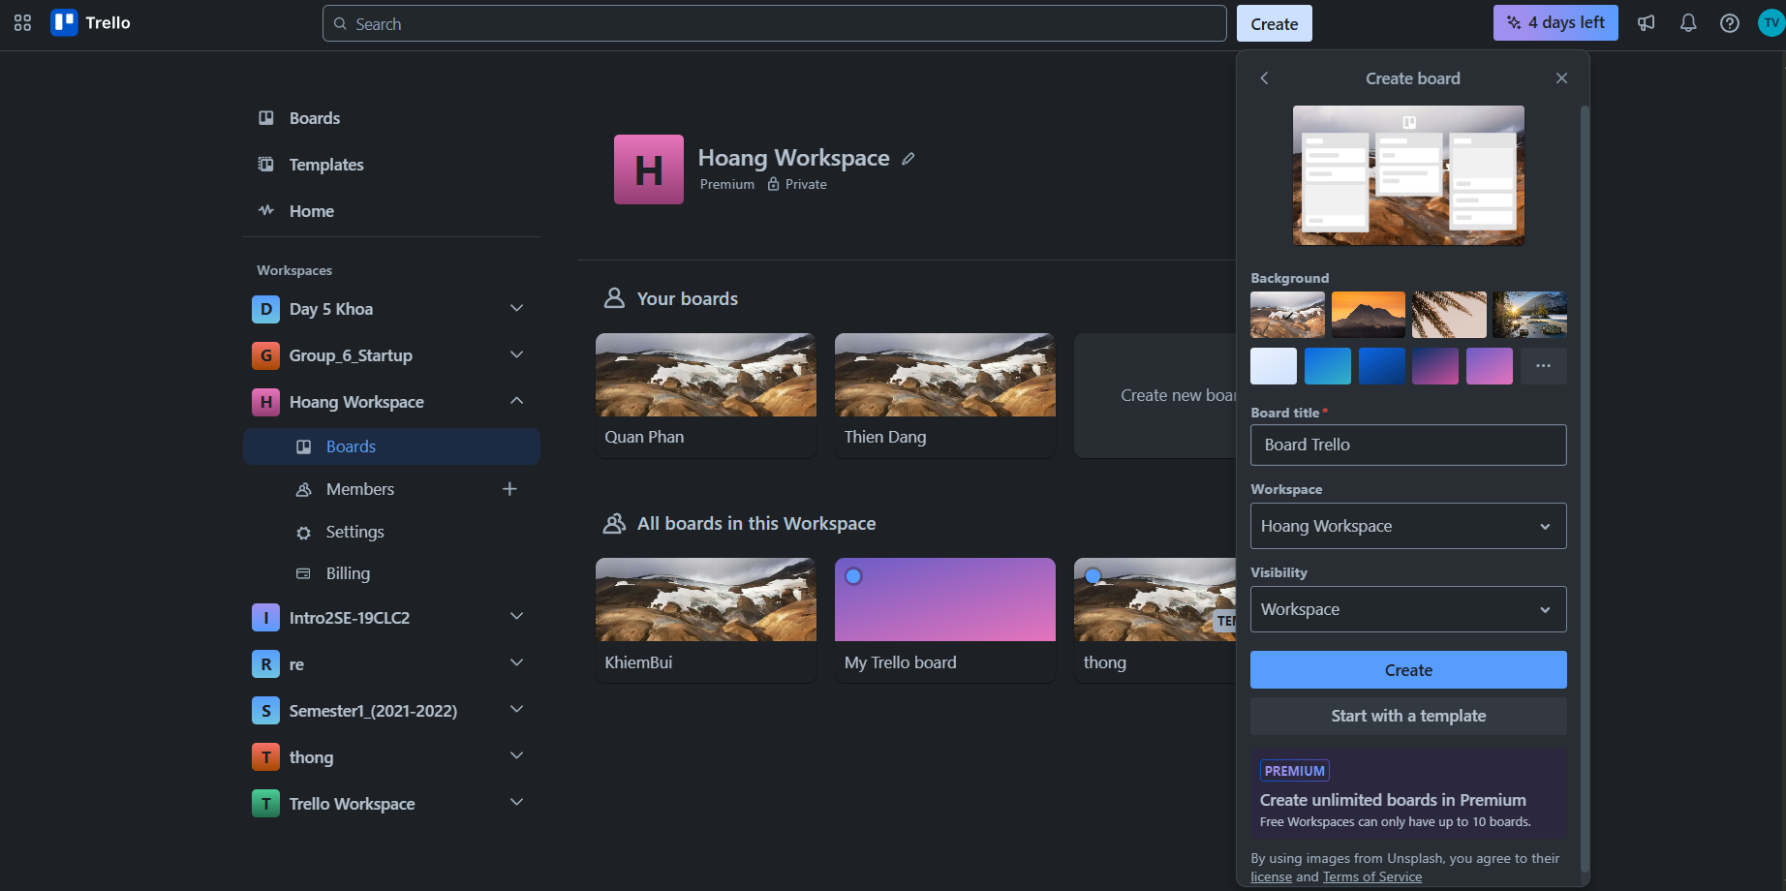
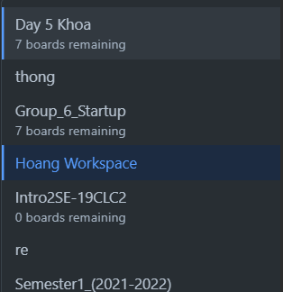
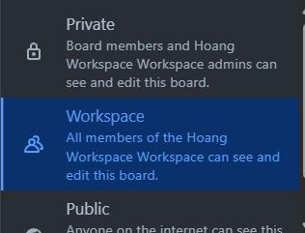
BOARD CREATE SCREEN
Click here
Board
BackgroundUrl
Workspace
WorkspaceName
BoardName
Click here
SettingKey
WorkspaceName
SettingValue
Click here
SettingOption

Slide 14
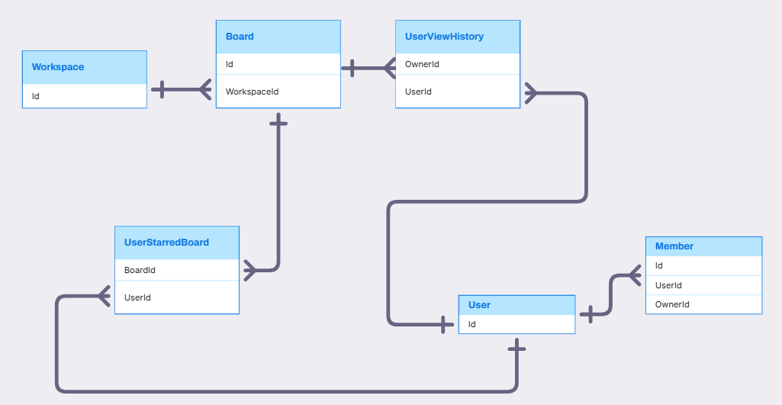
WORKSPACE, BOARD, USER RELATIONSHIP

Slide 15
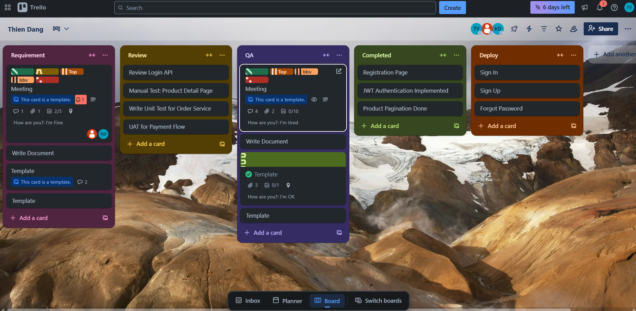
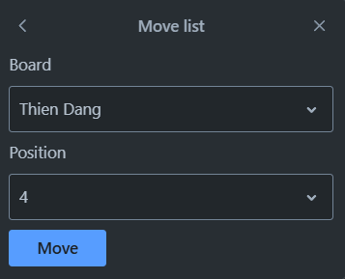
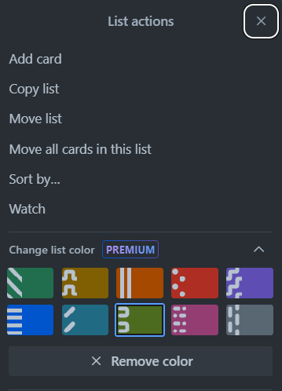

BOARD SCREEN
BoardTitle
Stage
Member
Attachment
Notification
User
StageTitle
Label
CardTitle
isTemplate
Comment
Checklist
Position
isComplete
Location
Card
CustomField
FieldValue
Icon
ColorHex
Color
Notes:
-- Board, Stage, Card
-- Get all list Stage of board(id=1) (Slide 33)
WITH get_board AS (
SELECT *
FROM Boards b
WHERE b.Id = 1
)
SELECT s.Id AS StageId, s.Title AS StageTitle, s.Position, c.ColorName
FROM Stages s
JOIN get_board gb ON gb.Id = s.BoardId
JOIN Colors c ON c.Id = s.ColorId
ORDER BY s.Position;
SELECT s.Id AS StageId, s.Title AS StageTitle, s.Position, c.ColorName
FROM Stages s
JOIN Boards b ON b.Id = s.BoardId
JOIN Colors c ON c.Id = s.ColorId
WHERE b.Id = 1
ORDER BY s.Position;
-- Get list Stage(position=3) of board(id=1) (Slide 33)
WITH get_board AS (
SELECT *
FROM Boards b
WHERE b.Id = 1
)
SELECT s.Id AS StageId, s.Title AS StageTitle, s.Position, c.ColorName
FROM Stages s
JOIN get_board gb ON gb.Id = s.BoardId
JOIN Colors c ON c.Id = s.ColorId
WHERE s.Position = 3
-- Get all card of stage(position=1) in board (id=3) (Slide 33)
SELECT c.Id, c.Title, c.CardDescription, c.CoverValue
FROM Cards c
JOIN Stages s ON c.StageId = s.Id
JOIN Boards b ON s.BoardId = b.Id
WHERE s.Position= 1 AND b.Id = 3;

Slide 16
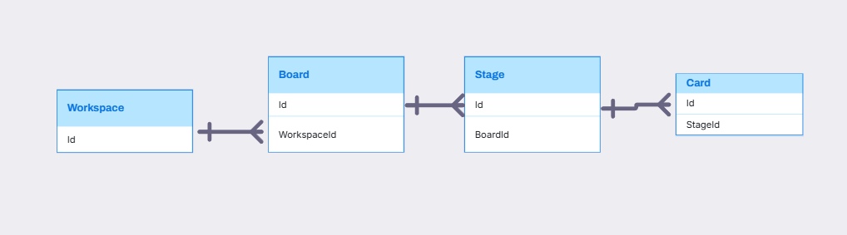
WORKSPACE, BOARD, STAGE, CARD RELATIONSHIP

Slide 17
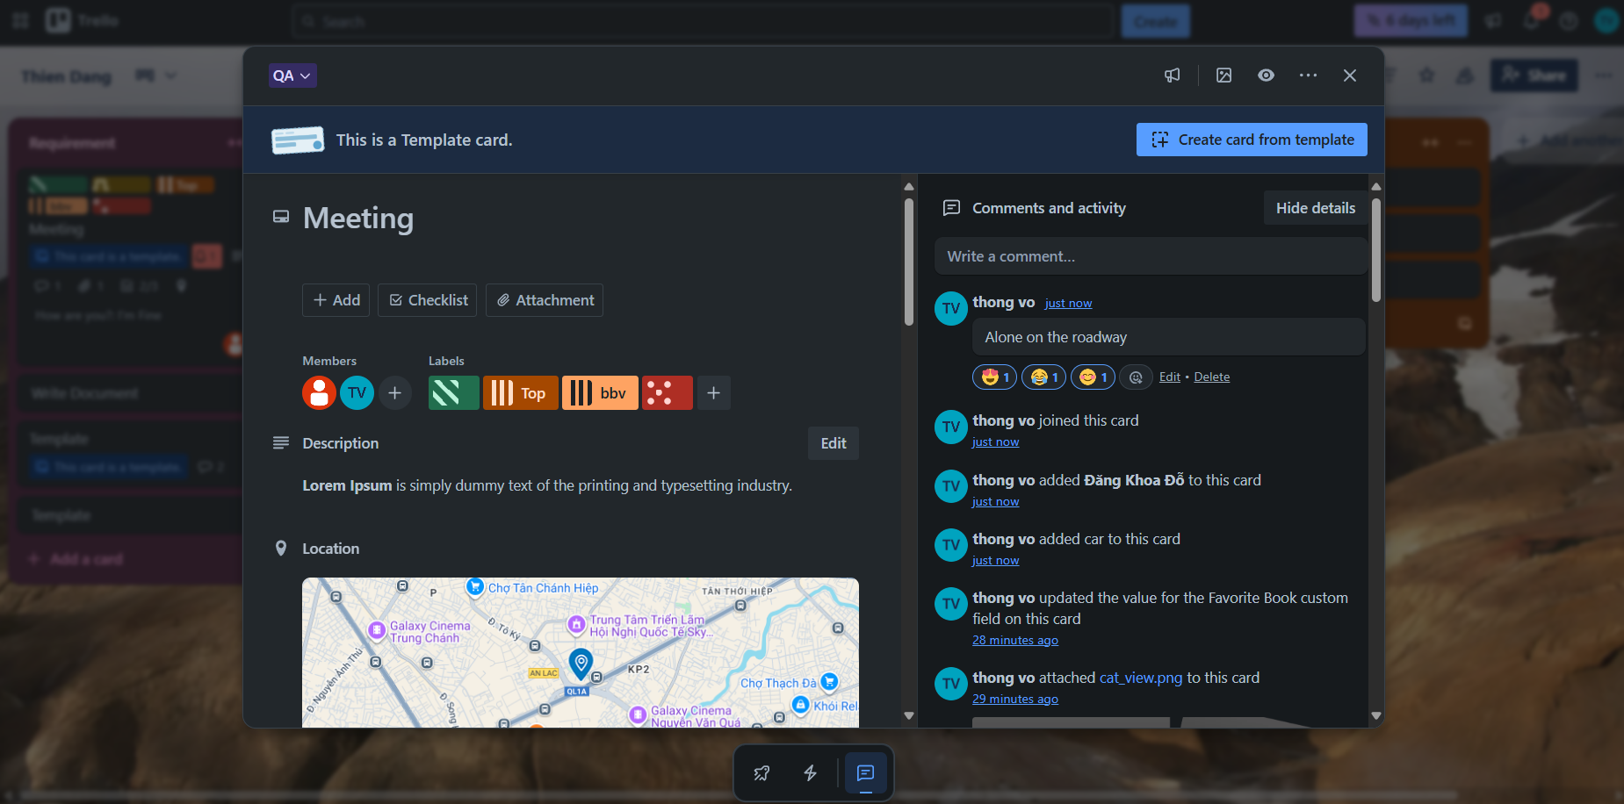
CARD SCREEN
Stage
StageTitle
Card
isTemplate
Member
CardTitle
User
Color
CreatedAt
IconColor
CardLabel
Content
Comment
NameColor
Member
Reaction
Label
CardLocation
CreatedAt
Activity
CardDescription
ActivityDescription
Notes:
-- Get members in card(id=1) (Slide 33)
SELECT u.Id, u.PictureUrl
FROM Members m
JOIN OwnerTypes ot ON ot.Id = m.OwnerTypeId
JOIN Cards c ON c.Id = m.OwnerId
JOIN Users u ON u.Id = m.UserId
WHERE ot.OwnerTypeValue = 'Card' AND c.Id = 1;
-- Get information card (id=219) of a stage(id=2), board(id=2) (Slide 34)
WITH CountAttachmentCard AS (
SELECT CardId, COUNT(*) AS number_of_attachment
FROM Attachments
GROUP BY CardId
),
CountChecklistItem AS (
SELECT cl.CardId, COUNT(*) AS number_of_checklist_item
FROM CheckLists cl
JOIN CheckListItems cli ON cli.CheckListId = cl.Id
GROUP BY cl.CardId
)
SELECT c.Id, c.Title, c.CardLocation, c.StartDate, c.DueDate, c.Position,
ISNULL(cac.number_of_attachment, 0) AS number_of_attachment,
ISNULL(ccl.number_of_checklist_item, 0) AS number_of_checklist_item,
col.Icon,
col.ColorName
FROM Cards c
LEFT JOIN CountAttachmentCard cac ON cac.CardId = c.Id
LEFT JOIN CountChecklistItem ccl ON ccl.CardId = c.Id
JOIN Stages s ON s.Id = c.StageId
JOIN Boards b ON b.Id = s.BoardId
JOIN CardLabels cl ON cl.CardId = c.Id
JOIN Labels l ON l.Id = cl.LabelId
JOIN Colors col ON col.Id = l.ColorId
WHERE c.Id =219 AND s.Id = 2 AND b.Id = 2;
-- Get labels of card(id=1) (Slide 35)
SELECT l.Id, col.ColorName, col.Icon
FROM Labels l
JOIN CardLabels cl ON cl.LabelId = l.Id
JOIN Cards c ON c.Id = cl.CardId
JOIN Colors col ON col.Id = l.ColorId
WHERE c.Id = 1;
-- Get comment of card (id = 1) (Slide 43)
SELECT c.Id, c.CardId, ca.Title AS CardTitle, c.Content, c.CreatedAt, c.Id AS CommentId, u.Username, u.PictureUrl
FROM Comments c
JOIN Cards ca ON ca.Id = c.CardId
JOIN Stages s ON s.Id = ca.StageId
JOIN Boards b ON b.Id = s.BoardId
JOIN Users u ON u.Id = c.CreatedBy
WHERE ca.Id = 1 AND s.Id = 159 AND b.Id = 159
-- Get reaction of comment's card (id = 104) (Slide 43)
SELECT r.Id, r.Icon, COUNT(*) AS NumberReaction
FROM Reactions r
JOIN CommentReactions cr ON cr.ReactionId = r.Id
JOIN Comments c ON c.Id = cr.CommentId
WHERE c.Id = 104
GROUP BY r.Id, r.Icon;

Slide 18
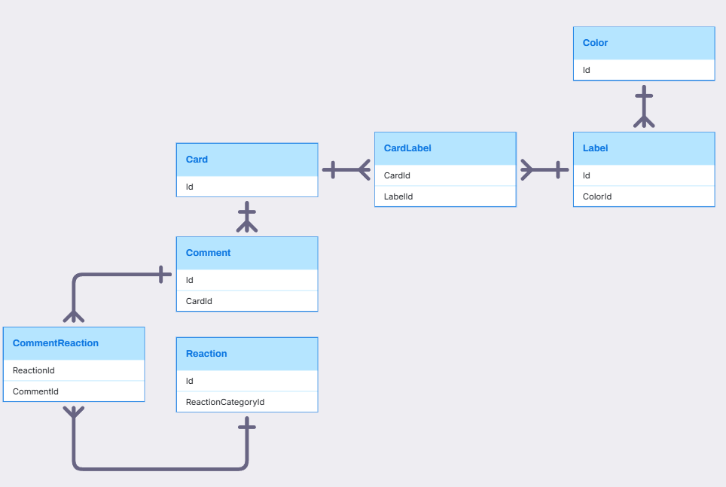
CARD, LABEL, COMMENT, COLOR RELATIONSHIP

Slide 19
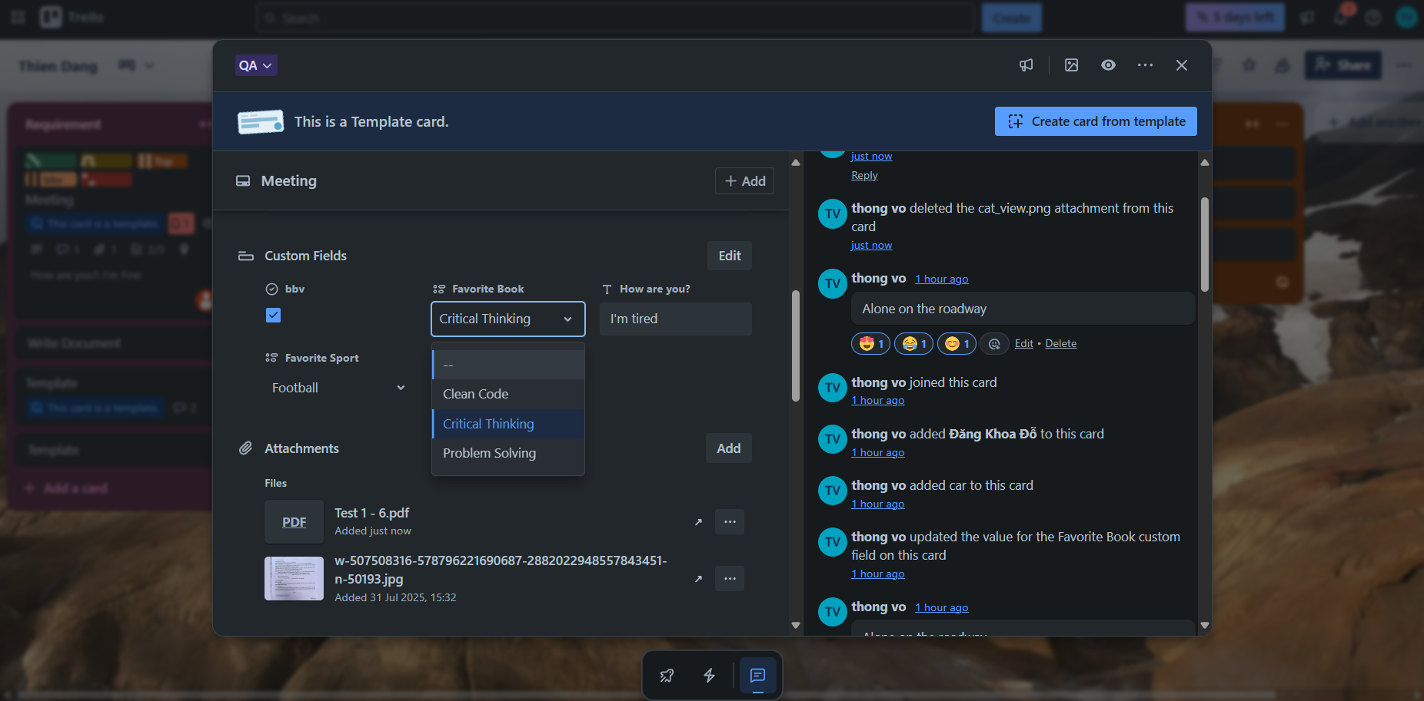
CARD SCREEN
Stage
StageTitle
User
Card
isTemplate
CardTitle
DataType
CustomFields
DataIcon
Activity
FieldItem
FieldValue
AttachmentName
Attachment
CreatedAt
AttachmentType
Notes:
-- Get activities of card(id=12) (Slide 36)
SELECT a.Id, a.ActivityDescription, a.CreatedAt, c.id, u.Username, u.PictureUrl
FROM Activities a
JOIN OwnerTypes ot ON ot.Id = a.OwnerTypeId
JOIN Cards c ON c.Id = a.OwnerId
JOIN Users u ON u.Id = a.UserId
WHERE ot.OwnerTypeValue = 'Card' AND c.Id = 1
ORDER BY a.CreatedAt DESC
-- Get attachments of card (id = 1) (Slide 42)
SELECT a.Id, a.AttachmentName, a.Link ,a.UploadAt, a.IsCover
FROM Attachments a
JOIN Cards c ON c.Id = a.CardId
WHERE c.Id = 50
ORDER BY UploadAt DESC
-- Show custom field WITH DROPDOWN TYPE and their field value of specific card
WITH FieldValuesWithCast AS(
SELECT
Id,
TRY_CAST(FieldValue AS INT) FieldValue,
CustomFieldId,
CardId
FROM FieldValues
)
SELECT
ctf.Id CustomFieldId,
ctf.Title CustomFieldTitle,
ftm.FieldItemValue,
ctf.Position CustomFieldPosition,
cgr.CategoryName,
fvl.CardId
FROM CustomFields ctf
JOIN FieldValuesWithCast fvl ON fvl.CustomFieldId = ctf.Id
JOIN FieldItems ftm ON ftm.Id = fvl.FieldValue
JOIN Categories cgr ON cgr.Id = ctf.CategoryId
WHERE CategoryName = 'DROPDOWN'
ORDER BY ctf.Position
-- Show custom field without dropdown type and their field value of specific card
SELECT
ctf.Id CustomFieldId,
ctf.Title CustomFieldTitle,
fvl.FieldValue,
cgr.CategoryName,
ctf.Position CustomFieldPosition,
crd.Id CardId,
brd.Id BoardId
FROM CustomFields ctf
LEFT JOIN FieldValues fvl ON fvl.CustomFieldId = ctf.Id
LEFT JOIN Cards crd ON crd.Id = fvl.CardId
JOIN Categories cgr ON cgr.Id = ctf.CategoryId
JOIN CategoryTypes ctt ON ctt.Id = cgr.CategoryTypeId
JOIN Stages stg ON stg.Id = crd.StageId
JOIN Boards brd ON brd.Id = stg.BoardId
WHERE CategoryName != 'DROPDOWN' AND ctt.CategoryTypeValue = 'DataTypes' AND brd.Id = 1 AND crd.Id = 1
ORDER BY ctf.Position
-- Show options of custom field with dropdown type of specific board
SELECT
ctf.Id,
ctf.Title,
ftm.Id,
ftm.FieldItemValue,
cgr.CategoryName,
ctf.Position,
ctf.BoardId
FROM CustomFields ctf
JOIN FieldItems ftm ON ftm.CustomFieldId = ctf.Id
JOIN Categories cgr ON cgr.Id = ctf.CategoryId
WHERE ctf.BoardId = 2 AND cgr.CategoryName = 'DROPDOWN'
ORDER BY ctf.Position

Slide 20
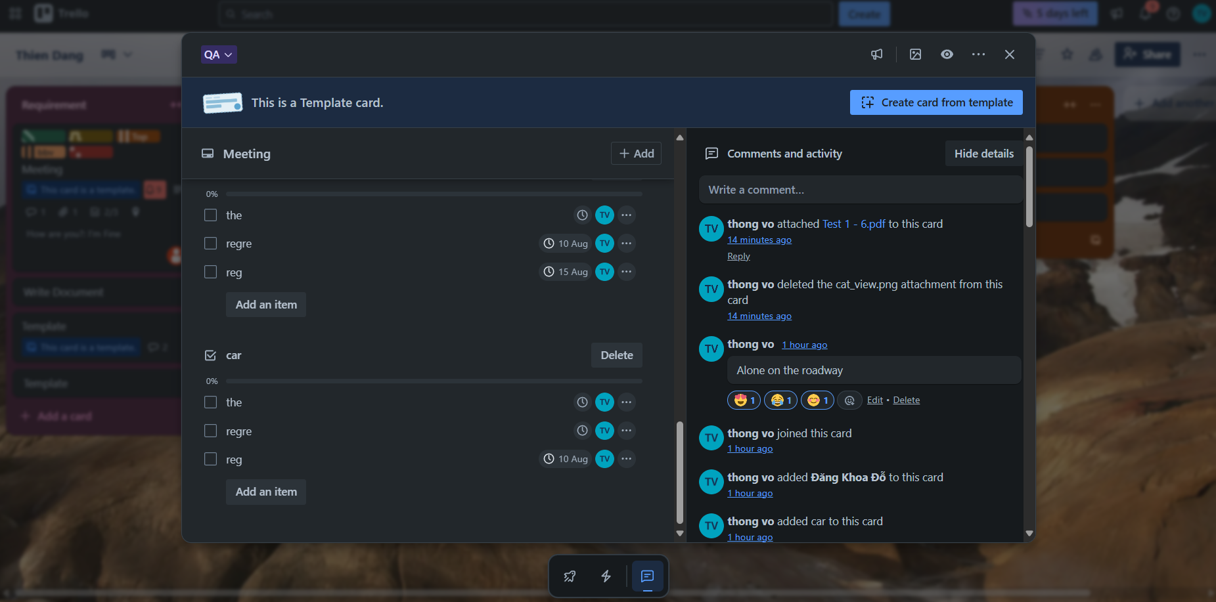
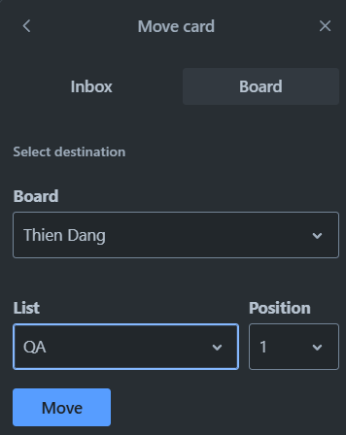
CARD SCREEN
StageTitle
isTemplate
Checklist
ChecklistItem
DueDate
CheckListItemName
CheckListItemStatus
CheckListtName
Position
User
Member
Notes:
-- Get list all checklist items assigned to the user. (Slide 40)
SELECT cl.Id, cl.CheckListName AS ChecklistName, cli.CheckListItemName AS ChecklistItemName ,cli.Position, cli.CheckListItemStatus , ca.Id AS CardId
FROM CheckListItems cli
JOIN CheckLists cl ON cl.Id = cli.CheckListId
JOIN Cards ca ON ca.Id = cl.CardId
JOIN Stages st ON st.Id = ca.StageId
JOIN Boards bo ON bo.Id = st.BoardId
JOIN Members me ON me.Id = cli.MemberId
JOIN Users us ON us.Id = me.UserId
WHERE ca.Id = 832

Slide 21
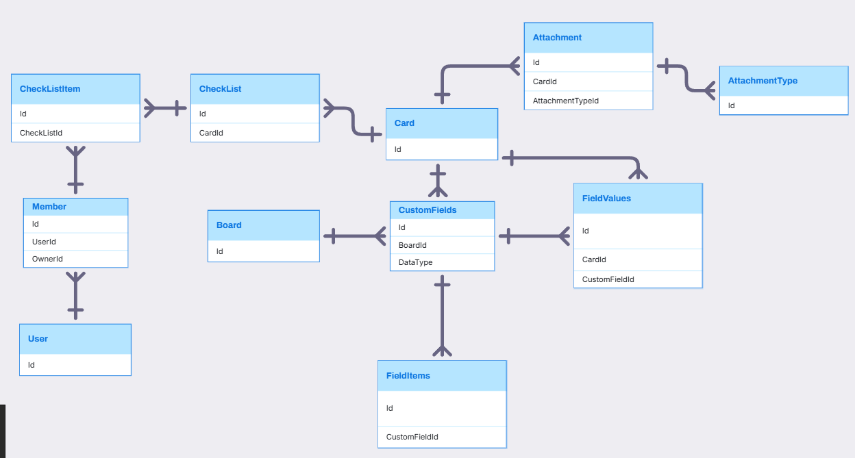
CARD, CUSTOMFIELD, CHECKLIST RELATIONSHIP

Slide 22
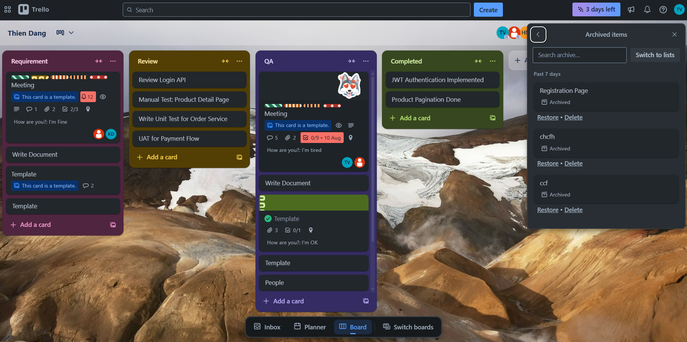
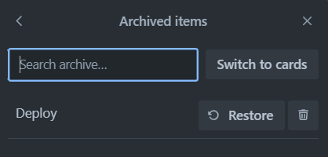
BOARD SCREEN
Stage
Card
StageName
CardName
CardStatus

Slide 23
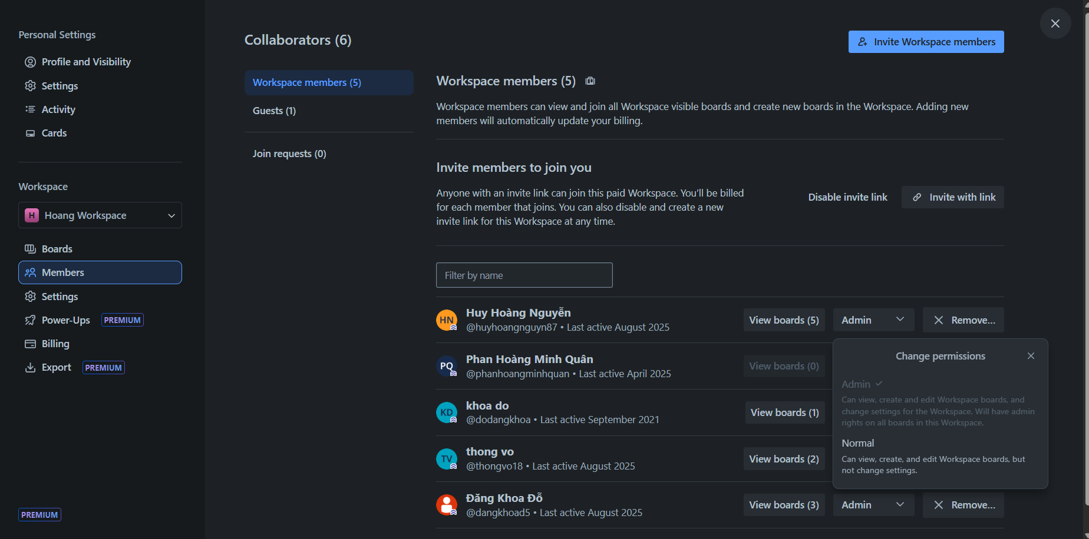
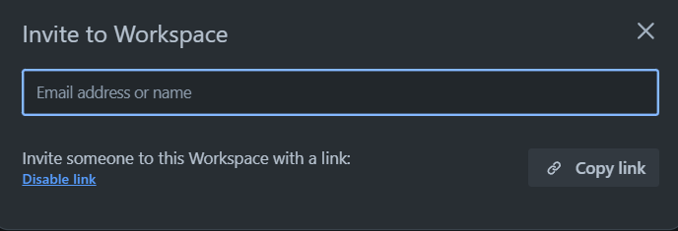
WORKSPACE MEMBER SCREEN
ShareLink
ShareLinkStatus
Workspace
OwnerType
Board
RolePermission
….
User
Member
UserAvatar
UserName
Notes:
-- Get list all board that User(i=1) is member for each Workspace (Slide 4)
SELECT b.Id AS BoardId, b.BoardName AS BoardName, w.WorkspaceName AS WorkspaceName, b.BackgroundUrl
FROM Boards b
JOIN Members m ON m.OwnerId = b.Id
JOIN Categories c ON m.CategoryId = c.Id
JOIN Workspaces w ON b.WorkspaceId = w.Id
JOIN Users u ON m.UserId = u.Id
WHERE u.Id = 1 AND c.CategoryName = 'BOARD’
-- Get all members of the board(id=1) with permissions (Slide 13)
SELECT m.Id, u.PictureUrl, u.Username, u.Email ,rp.RolePermissionName
FROM Members m
JOIN Boards b ON b.Id = m.OwnerId
JOIN OwnerTypes o ON o.Id = m.OwnerTypeId
JOIN RolePermissions rp ON rp.Id = m.PermissionId
JOIN Users u ON u.Id = m.UserId
WHERE o.OwnerTypeValue = 'Board' AND b.Id = 1;

Slide 24
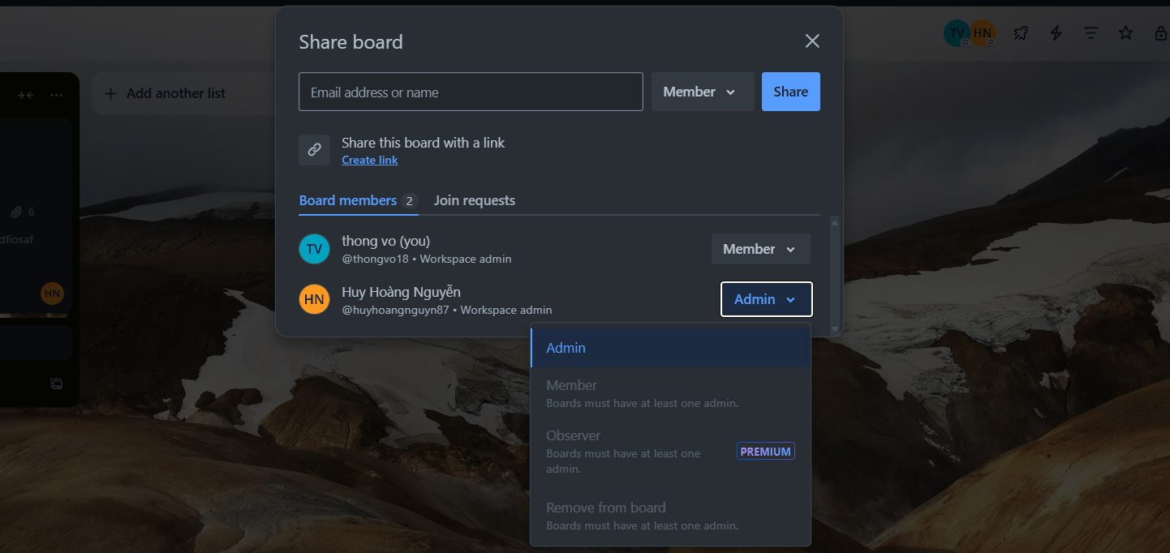
BOARD MEMBER SCREEN
OwnerType
ShareLink
User
Member
Avatar
UserName
Permission
PermissionName
Notes:
SELECT sl.Token, sl.ShareLinkStatus
FROM ShareLinks sl
JOIN Workspaces w ON w.Id = sl.OwnerId
JOIN RolePermissions p ON sl.PermissionId = p.Id
WHERE w.Id = 9;
-- Get all members of the board(id=1) with permissions (Slide 13)
SELECT m.Id, u.PictureUrl, u.Username, u.Email ,rp.RolePermissionName
FROM Members m
JOIN Boards b ON b.Id = m.OwnerId
JOIN OwnerTypes o ON o.Id = m.OwnerTypeId
JOIN RolePermissions rp ON rp.Id = m.PermissionId
JOIN Users u ON u.Id = m.UserId
WHERE o.OwnerTypeValue = 'Board' AND b.Id = 1;

Slide 25
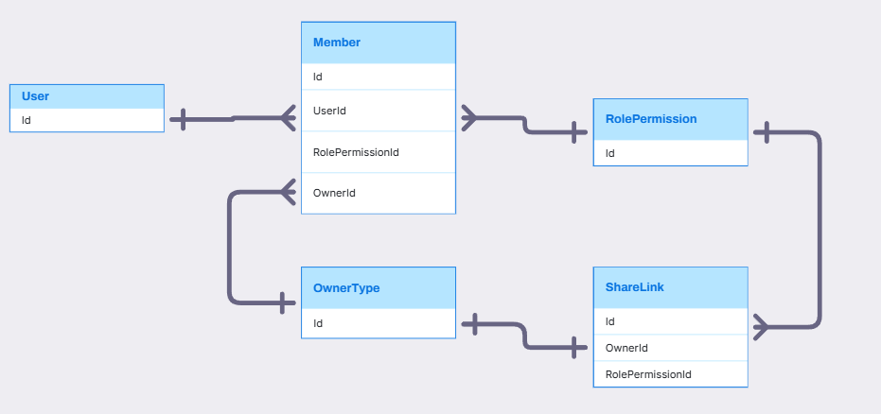
MEMBER, ROLEPERMISSION, SHARELINK RELATIONSHIP

Slide 26
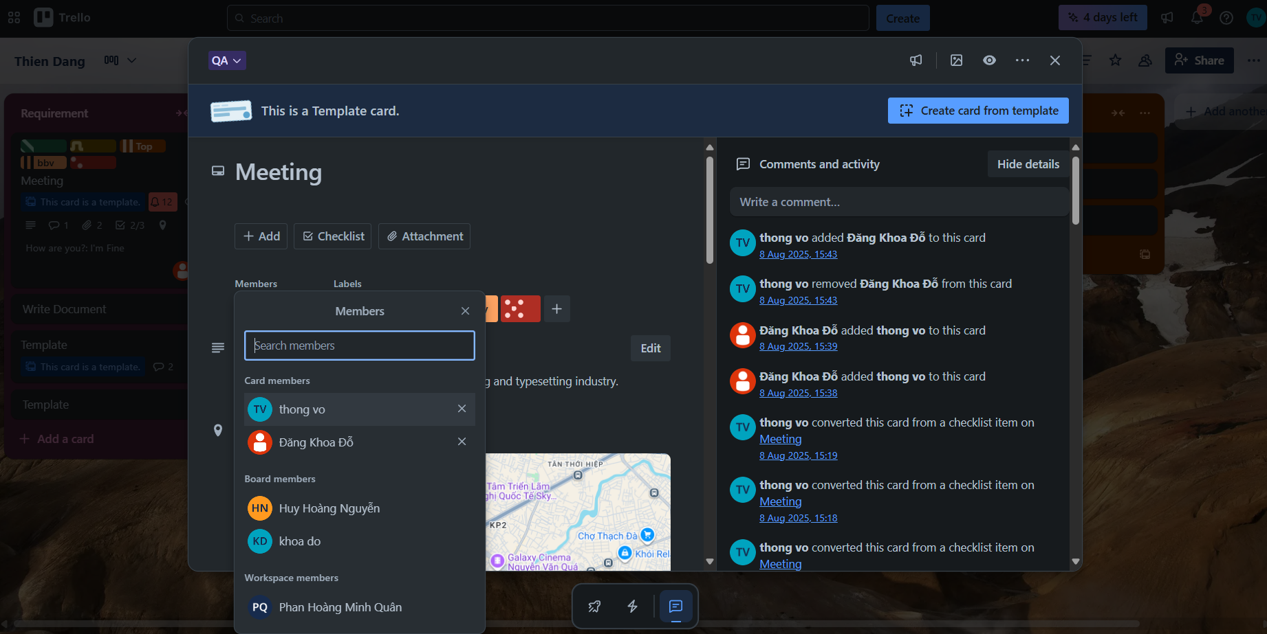
CARD MEMBER SCREEN
User
OwnerType
Member

Slide 27
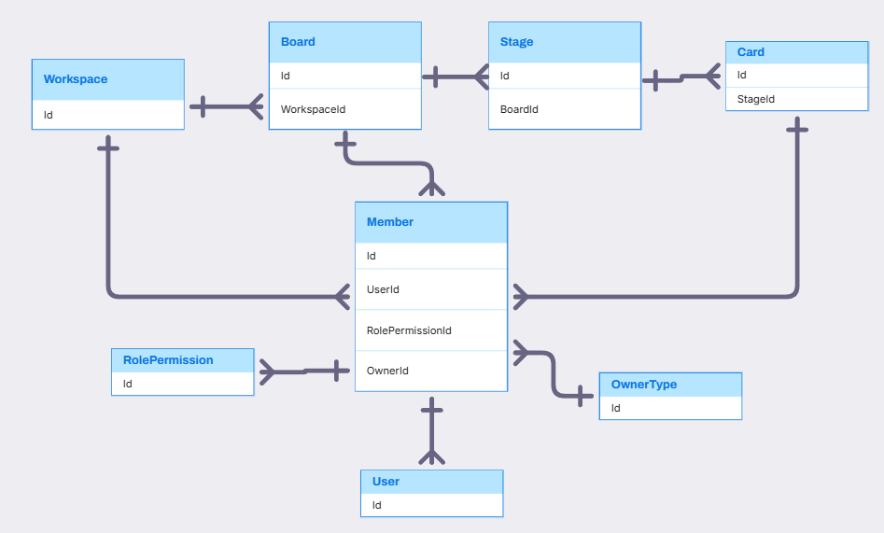
WORKSPACE, BOARD, CARD, MEMBER RELATIONSHIP

Slide 28
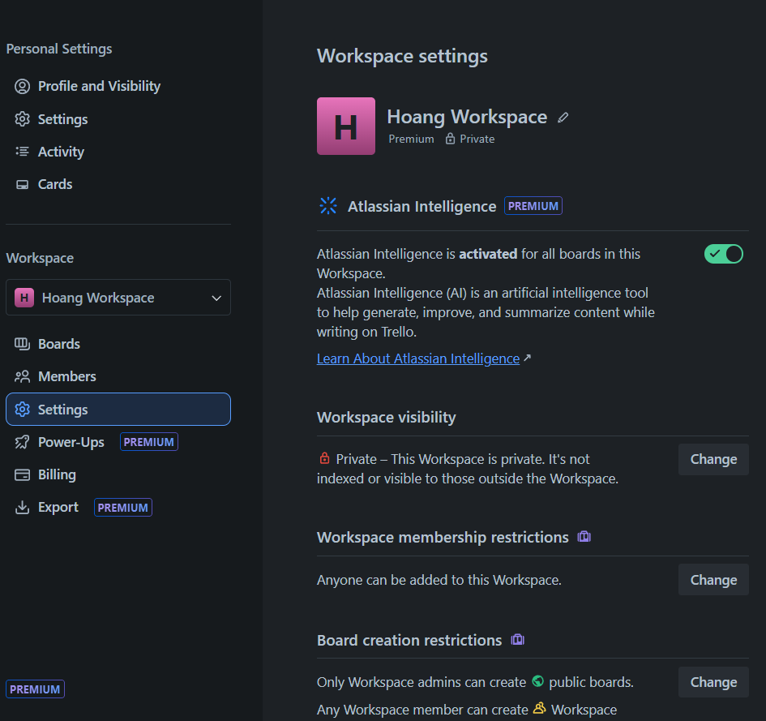
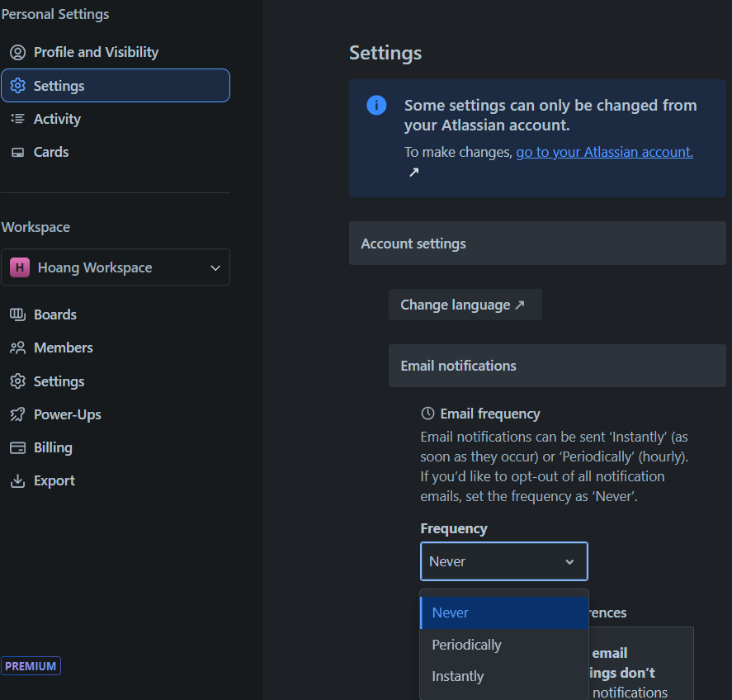
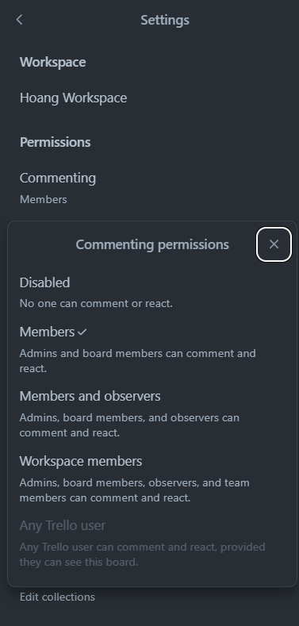
SETTINGS SCREEN
Workspace
User
Board
OwnerType
SettingKey
SettingKey
KeyName
KeyName
Description
SettingKey
DisplayValue
KeyName
SettingValue
DisplayValue
Description
SettingOption
SettingValue
DisplayValue
SettingOption
SettingKeySettingOption
Notes:
-- Setting
-- Select all settingkey of Workspace with value
SELECT sk.Id, sk.KeyName, so.DisplayValue, sv.SettingContent
FROM SettingValues sv
JOIN SettingKeys sk ON sv.SettingKeyId = sk.Id AND sk.DataTypeId = 1
JOIN OwnerTypes ot ON sk.OwnerTypeId = ot.Id
JOIN SettingOptions so ON so.Id = sv.SettingContent
JOIN Workspaces w ON w.Id = sv.OwnerId
WHERE ot.OwnerTypeValue = 'WORKSPACE' AND w.Id = 6
-- Get setting workspace(id=7) visibility(value=22, user=7) (Slide 17)
SELECT w.Id, w.WorkspaceName, sk.KeyName, so.DisplayValue
FROM SettingKeys sk
JOIN SettingValues sv ON sv.SettingKeyId = sk.Id
JOIN SettingOptions so ON so.Id = sv.SettingValue
JOIN OwnerTypes ot ON ot.Id = sk.OwnerTypeId
JOIN Workspaces w ON w.Id = sv.OwnerId
JOIN Users u ON u.Id = w.CreatedBy
WHERE ot.OwnerTypeValue = 'Workspace' AND sk.KeyName = 'workspacevisibility' AND u.Id = 7 AND w.Id = 7;
-- Get SettingKeys and SettingOptions of this SettingKeys for Workspace (Slide 17)
SELECT sk.KeyName, so.DisplayValue
FROM SettingKeys sk
JOIN SettingKeySettingOptions skso ON skso.SettingKeyId = sk.Id
JOIN SettingOptions so ON so.Id = skso.SettingOptionId
JOIN OwnerTypes ot ON ot.Id = sk.OwnerTypeId
WHERE ot.OwnerTypeValue = 'Workspace'
GROUP BY sk.KeyName, so.DisplayValue
-- Get all setting keys of user (id=1) with option value (Slide 18)
SELECT sk.KeyName, sv.SettingValue AS SettingValueId, so.DisplayValue AS SettingOption, u.Id
FROM SettingKeys sk
JOIN SettingValues sv ON sv.SettingKeyId = sk.Id
JOIN OwnerTypes ot ON sk.OwnerTypeId = ot.Id
JOIN SettingOptions so ON so.Id = sv.SettingValue
JOIN Users u ON u.Id = sv.OwnerId
WHERE ot.OwnerTypeValue = 'User' AND u.Id = 6
ORDER BY sk.KeyName;

Slide 29
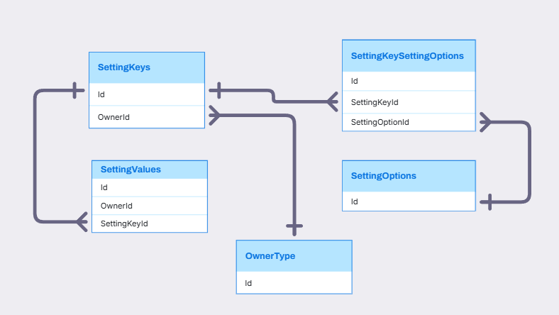
WORKSPACE, BOARD, CARD, SETTING RELATIONSHIP

Slide 30
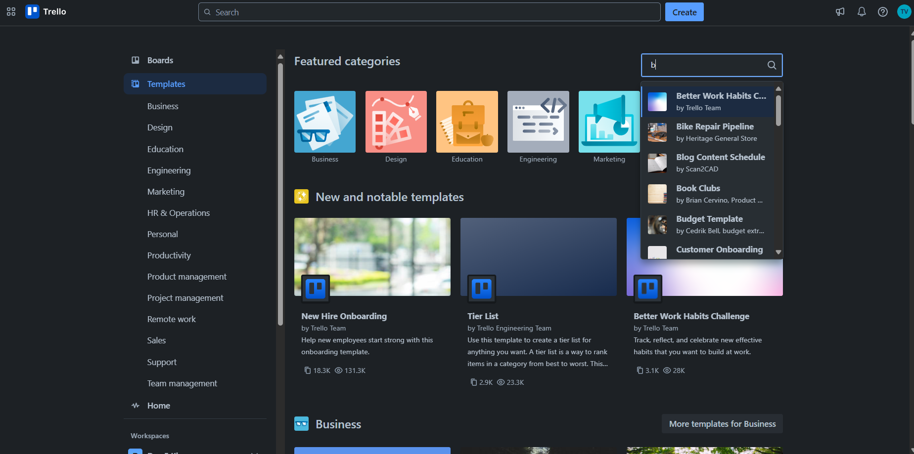
TEMPLATE SCREEN
TeamplateCategory
IconUrl
CategoryValue
Board
Teamplate
User
PictureUrl
BackgroundUrl
User
Title
UserName
Description
TeamplateCopied
TeamplateView
Notes:
-- Template
-- Get all template categories. (Slide 5)
SELECT TOP 7 c.Id, c.CategoryName , c.Icon
FROM Categories c
JOIN CategoryTypes ct ON ct.Id = c.CategoryTypeId AND ct.Id = 6
-- Get top 3 most viewed templates. (Slide 5)
SELECT TOP 3 t.Id, t.Title, t.TemplateDescription, t.Copied, t.Viewed, t.BackgroundUrl
FROM Templates t
ORDER BY Viewed DESC
-- Search templates by keyword in title. (Slide 5)
SELECT t.Id, t.Title, t.BackgroundUrl , u.Username
FROM Templates as t
JOIN Boards b ON b.Id = t.BoardId
JOIN Users u ON u.Id = t.CreatedBy
WHERE Title LIKE '%B%';
-- Get list templates in a specific category (e.g., 'Design'). (Slide 6)
SELECT t.Id, t.Title, t.TemplateDescription, t.Copied, t.Viewed, t.BackgroundUrl
FROM Templates t
JOIN Categories c ON c.Id = t.CategoryId
JOIN CategoryTypes ct ON ct.Id = c.CategoryTypeId
WHERE ct.Id = 6 and c.CategoryName ='Design'
-- Get information templates(category = 'Design', id=22) (Slide 7)
SELECT t.Id, t.Title, t.TemplateDescription, t.Copied, t.Viewed, t.BackgroundUrl
FROM Templates t
JOIN Categories c ON c.Id = t.CategoryId
JOIN CategoryTypes ct ON ct.Id = c.CategoryTypeId
WHERE ct.Id = 6 and c.CategoryName ='Design' AND t.Id ='22'
-- Get information templates from board (use templates) (Slide 7)
SELECT t.Id, t.Title, t.TemplateDescription, t.Copied, t.Viewed, b.BackgroundUrl, b.BoardName
FROM Templates t
JOIN Boards b ON b.id = t.BoardId
WHERE t.Id = 1;

Slide 31
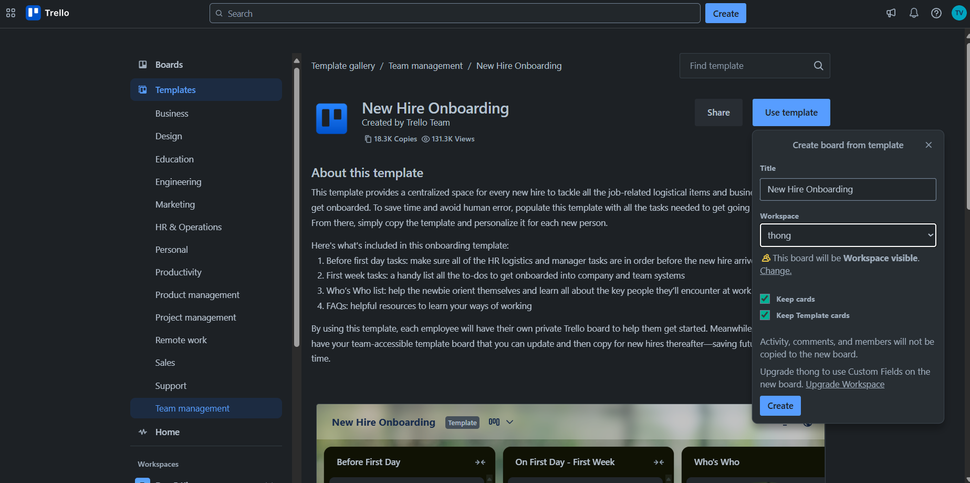
TEMPLATE SCREEN
Teamplate
User
PictureUrl
Title
Name
TeamplateCopied
TeamplateView
BoardName
WorkSpaceName
Description
Notes:
-- Template
-- Get all template categories. (Slide 5)
SELECT TOP 7 c.Id, c.CategoryName , c.Icon
FROM Categories c
JOIN CategoryTypes ct ON ct.Id = c.CategoryTypeId AND ct.Id = 6
-- Get top 3 most viewed templates. (Slide 5)
SELECT TOP 3 t.Id, t.Title, t.TemplateDescription, t.Copied, t.Viewed, t.BackgroundUrl
FROM Templates t
ORDER BY Viewed DESC
-- Search templates by keyword in title. (Slide 5)
SELECT t.Id, t.Title, t.BackgroundUrl , u.Username
FROM Templates as t
JOIN Boards b ON b.Id = t.BoardId
JOIN Users u ON u.Id = t.CreatedBy
WHERE Title LIKE '%B%';
-- Get list templates in a specific category (e.g., 'Design'). (Slide 6)
SELECT t.Id, t.Title, t.TemplateDescription, t.Copied, t.Viewed, t.BackgroundUrl
FROM Templates t
JOIN Categories c ON c.Id = t.CategoryId
JOIN CategoryTypes ct ON ct.Id = c.CategoryTypeId
WHERE ct.Id = 6 and c.CategoryName ='Design'
-- Get information templates(category = 'Design', id=22) (Slide 7)
SELECT t.Id, t.Title, t.TemplateDescription, t.Copied, t.Viewed, t.BackgroundUrl
FROM Templates t
JOIN Categories c ON c.Id = t.CategoryId
JOIN CategoryTypes ct ON ct.Id = c.CategoryTypeId
WHERE ct.Id = 6 and c.CategoryName ='Design' AND t.Id ='22'
-- Get information templates from board (use templates) (Slide 7)
SELECT t.Id, t.Title, t.TemplateDescription, t.Copied, t.Viewed, b.BackgroundUrl, b.BoardName
FROM Templates t
JOIN Boards b ON b.id = t.BoardId
WHERE t.Id = 1;

Slide 32
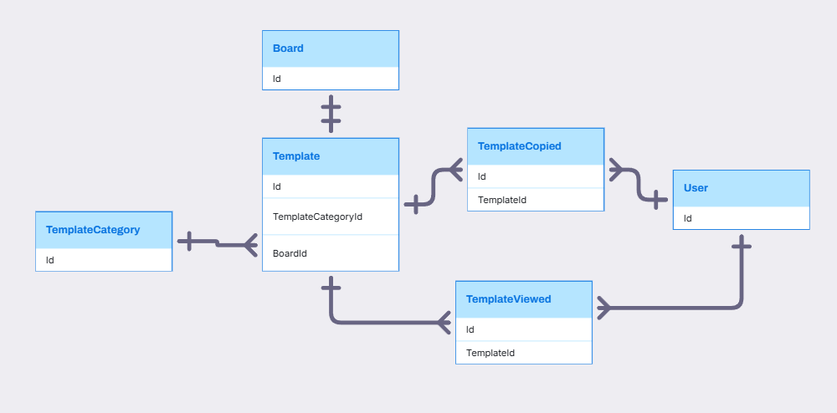
BOARD, TEMPLATE, USER RELATIONSHIP

Slide 33
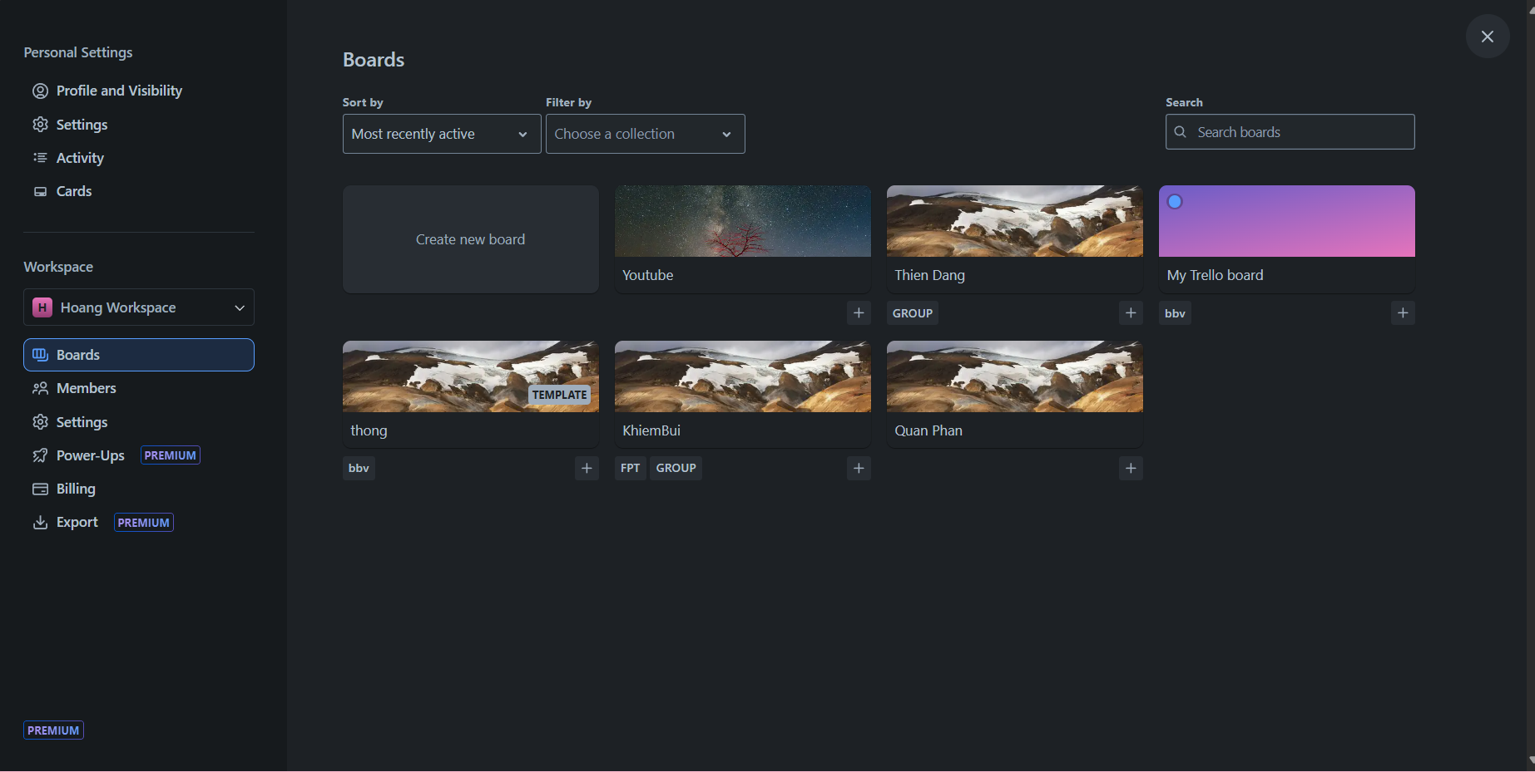
BOARD COLLECTION SCREEN
BoardCollection
BackgroudUrl
BoadName
CollectionName
Notes:
-- Get list boards in collection (id = 1) (Slide 52)
SELECT b.BoardName ,co.CollectionName
FROM BoardCollections bc
JOIN Boards b ON b.Id = bc.BoardId
JOIN Collections co ON co.Id = bc.CollectionId
WHERE b.WorkspaceId = 1

Slide 34
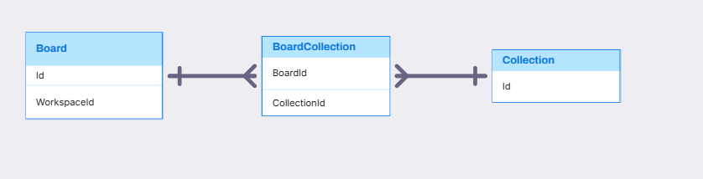
BOARD, COLLECTION RELATIONSHIP

Slide 35
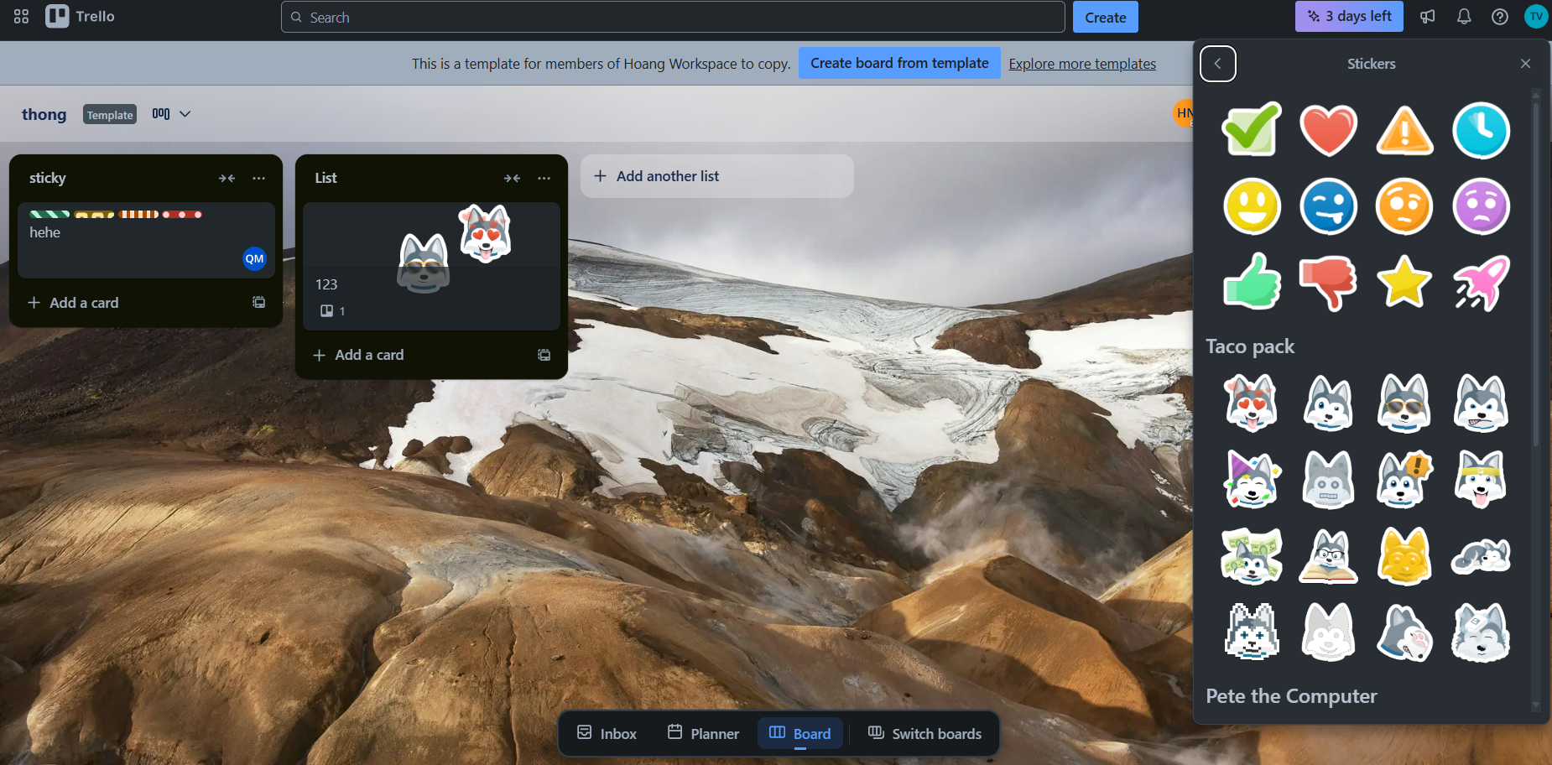

CARD STICKER SCREEN
Sticker
CardSticker
StickerCategory
DisplayValue
StickerUrl
Notes:
-- Get list sticker (Slide 47)
SELECT s.Id, s.StickerName, s.StickerUrl
FROM Stickers s
-- Get stickers of card(id=1) (Slide 47)
SELECT s.Id, s.StickerName, s.StickerUrl
FROM Stickers s
JOIN CardStickers cs ON cs.StickerId = s.Id
JOIN Cards c ON c.Id = cs.CardId
WHERE c.Id = 1

Slide 36
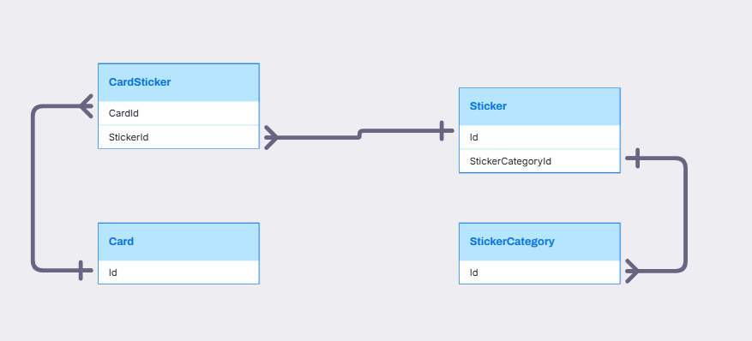
CARD AND STICKER RELATIONSHIP

Slide 37
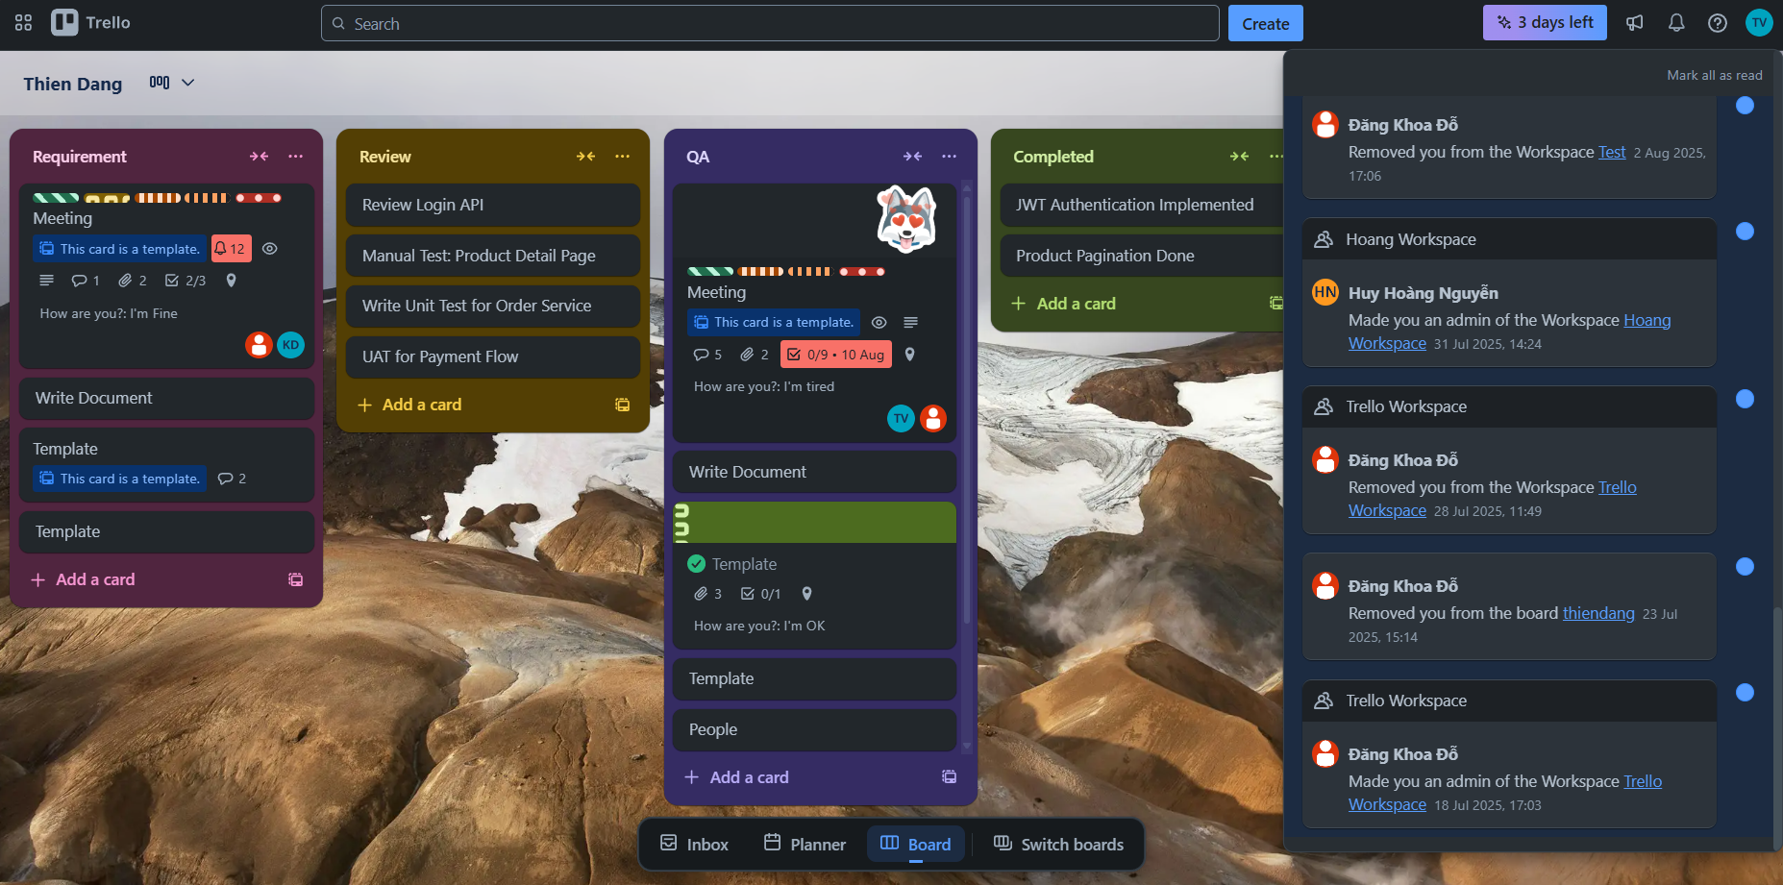
NOTIFICATION SCREEN
IsRead
Notification
Activity
User
WorkspaceName
OwnerType
Description
CreatedAt
Workspace
Board
Workspace
Card
Notes:
-- Get list all recent card's activities in the user's card. (Slide 49)
SELECT ca.Title , wo.WorkspaceName AS WorkSpace , bo.BoardName AS Board, st.Title , u.Username , u.PictureUrl , ac.ActivityDescription,
DATEDIFF(DAY,ac.CreatedAt, GETDATE()) AS day_ago
FROM (SELECT UserId, CategoryId , OwnerId, ActivityDescription, CreatedAt
FROM Activities
WHERE CategoryId = 3) ac
JOIN Cards ca ON ca.Id = ac.OwnerId
JOIN Stages st ON st.Id = ca.StageId
JOIN Boards bo ON bo.Id = st.BoardId
JOIN Workspaces wo ON wo.Id = bo.WorkspaceId
JOIN Users u ON u.Id = ac.UserId
WHERE u.Id = 1
Order By day_ago;
-- Show Activities unread notifications of the user. (Slide 50)
SELECT a.Id, u.Username, u.PictureUrl, a.ActivityDescription, a.CreatedAt
FROM Activities a
JOIN Notifications n ON a.Id = n.ActivityId
JOIN Users u ON u.Id = a.UserId
WHERE u.Id = 2 AND n.IsRead = 0
-- Count total number of unread notifications of the user. (Slide 50)
SELECT COUNT(ac.UserId) AS NumberOfNotifications
FROM Notifications n
JOIN Activities ac ON ac.Id = n.ActivityId
WHERE ac.UserId = 2 AND n.IsRead = 0;

Slide 38
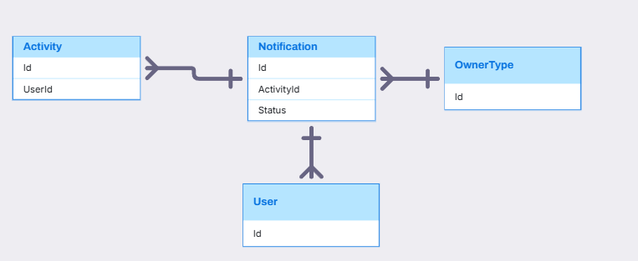
NOTIFICATION, ACTIVITY RELATIONSHIP

Slide 39

Q&A
Thank you
Intern | Trello Team

Slide 41
bbv template EN
How-to guides

Slide 42
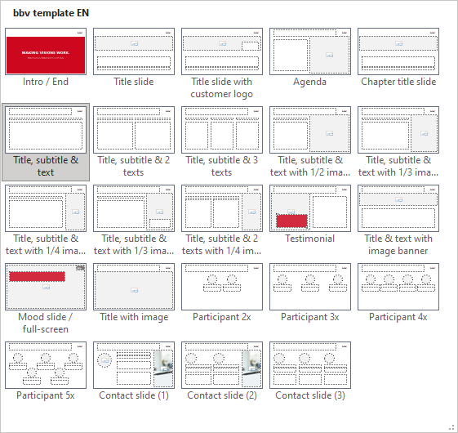
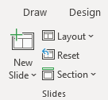
bbv Master layouts & slide library
Insert new slide
1
Click on «New Slide»
1
2
Select layout
Choose the desired layout from the pre-programmed master layouts.
2
🡪
Or select layout from slide library

Slide 43
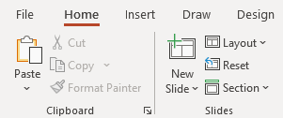
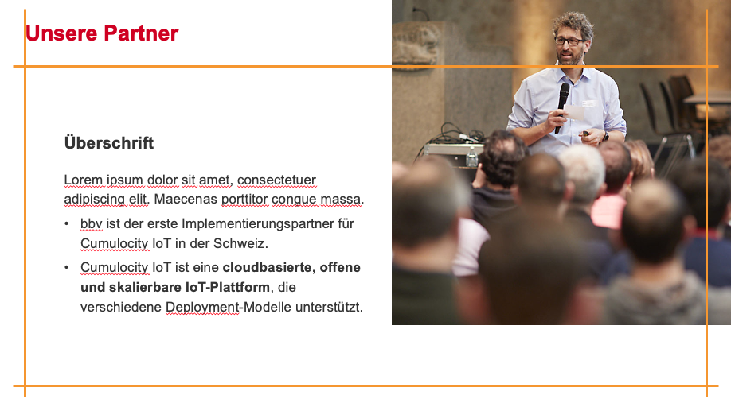
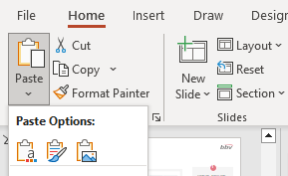

Transfer of existing slides into the new Master
1
2
3
4
Insert original slide
Copy slide in original presentation with Ctrl+C.
In the target presentation, select the slide after which the original slide is to be inserted.
Select in the tab «Home / Paste / Use Destination Theme».
Assign slide layout
Select the inserted slide
Select the desired layout in the tab «Home / Layout».
Adjust slide manually
Check all slide contents such as text blocks, images, etc. for position and size and manually adjust them to the new layout grid.
Check design
Independently check:
Font type, sizes and font colours
Colours of graphic elements
Text alignment
Coherence of the overall picture
Important:
When transferring existing slides, always carry out all four steps.

Slide 44


Change icon colour
Approach
Notes
Select icon
In the tab «Graphics Format» under «Graphics Styles», use «Graphics Fill» to change the colour
For some icons, the colour can be changed by using «Graphics Outline» instead of «Graphics Fill».
The colour cannot be changed if an icon is inserted as a picture. In this case, after selecting the icon, the tab «Picture Format» appears instead of «Graphics Format».
Best vector file format for icons: *.svg

Slide 45






Insert image into placeholder
Insert image from external source
Click on the image icon, select image from Sharepoint or other source
The bbv image library is here locally located: C:\Users\Public\bbv_templates\Marketing\PPT-Bibliotheken\Bilder-Bibliothek
Or: copy image from external source with Ctrl+C, select the placeholder, then paste with Ctrl+V
Adjust
Select the image
Click in the tab «Picture Format» on «Crop»
Adjust the image composition by moving the image
Resize the image by clicking and dragging the outer circles.
Click again on «Crop» to finish the adjustments

Slide 46






Insert image into mock-up screen (mobile/laptop)
Mock-up
Paste image
Copy image from external source with Ctrl+C and paste with Ctrl+V
Image mask
Adjust size & determine image area:
Place image behind image mask
Adjust image size and determine image area
Image mask
Crop image to image mask
Select image
Select image mask
Click in the tab «Shape Format / Merge Shapes» on «Intersect»
Combine image with mock-up
Place image behind mock-up
Activate image and mock-up and align both horizontally (Align Center) and vertically (Align Middle)
Group image and mock-up with Ctrl+G

Slide 47
bbv template EN
Style guide

Slide 48



Working area, guides & ruler
Working area
Depending on the slide, a single-column layout, a 2-column or 3-column layout is used.
Display the ruler and guides in the «View» tab.

Slide 49


bbv colour theme
Always OK!
Never, please!
Default text colours
Main accent
Colours for diagrams, charts, graphs etc.
Use selectively and sparingly
Never, please!
Colours for diagrams, charts, graphs etc.
Colours for diagrams, charts, graphs etc.

